Slide 1
15/03/2022
Title: Rules
Aims:
Understand that Number and Algebra use the same rules.
Describe like terms
Plan:
Daily review:
Number rules revisited.
Number relationships.
Simplify expressions.

Slide 2
The word is
Pronumeral
A letter or symbol used in place of a number
Pronumerals represent numbers, so they MUST follow the same rules as numbers.

Slide 3
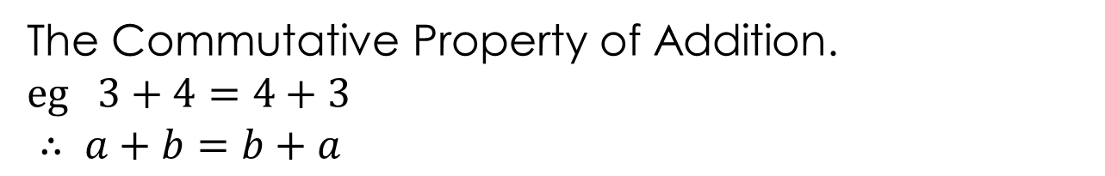
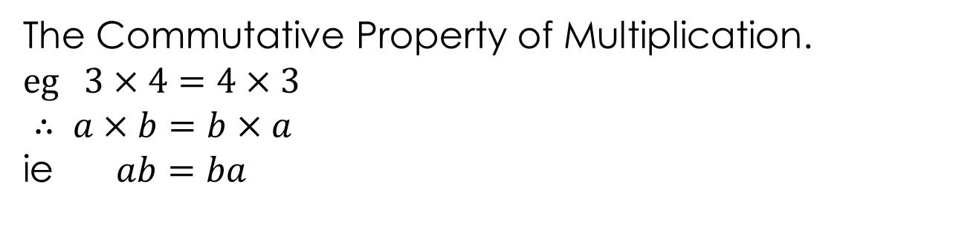
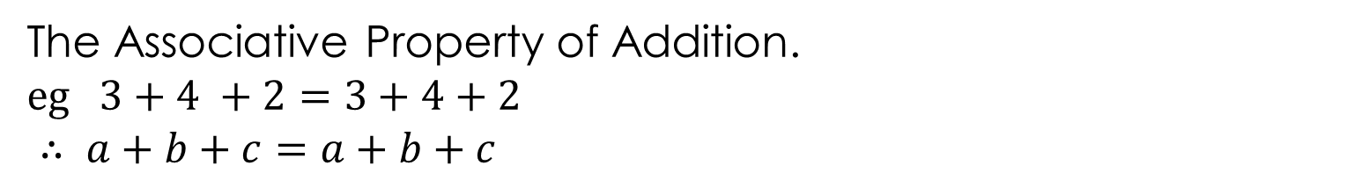
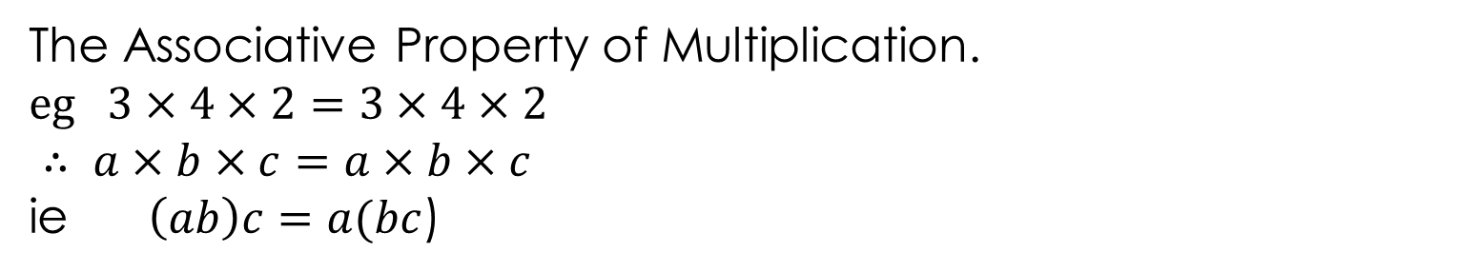
Daily review
Some number properties.
The Commutative Property of Multiplication.
$eg 3×4=4×3$
$∴ a×b=b×a$
ie $ab=ba$
The Commutative Property of Addition.
$eg 3+4=4+3$
$∴ a+b=b+a$
The Associative Property of Multiplication.
$eg 3×4×2=3×4×2$
$∴ a×b×c=a×b×c$
ie $\left(ab\right)c=a(bc$)
( )
( )
( )
( )
The Associative Property of Addition.
$eg 3+4 +2=3+4+2$
$∴ a+b+c=a+b+c$
( )
( )
( )
( )

Slide 4
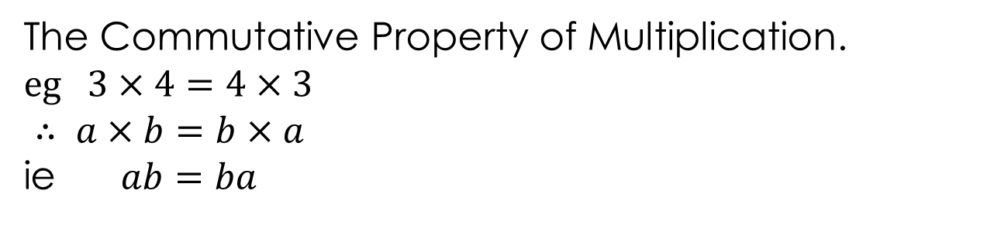
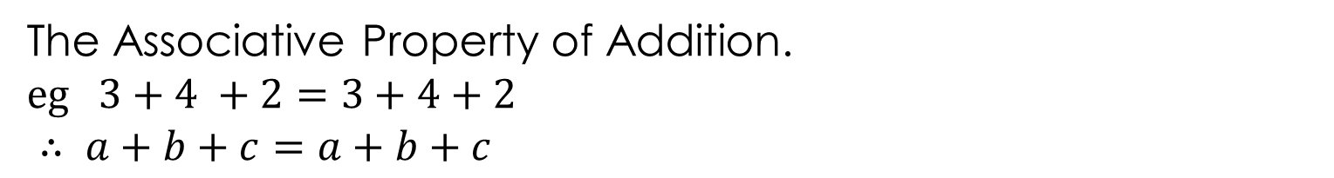
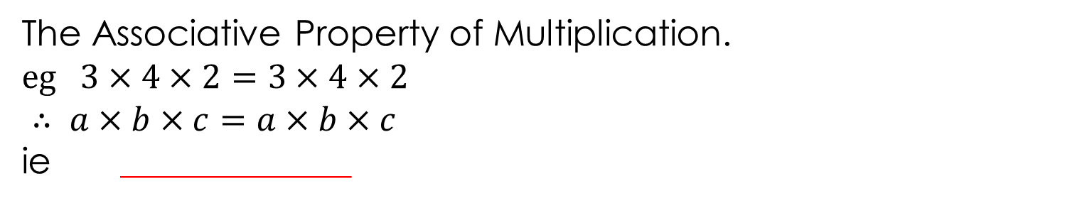
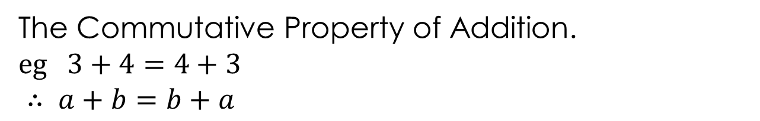
Daily review
Some number properties.
The Commutative Property of Multiplication.
$eg 3×4=4×3$
$∴ a×b=b×a$
ie $ab=ba$
The Commutative Property of Addition.
$eg 3+4=4+3$
$∴ a+b=b+a$
The Associative Property of Multiplication.
$eg 3×4×2=3×4×2$
$∴ a×b×c=a×b×c$
ie _____________
The Associative Property of Addition.
$eg 3+4 +2=3+4+2$
$∴ a+b+c=a+b+c$
Notes:
Student worksheet

Slide 5
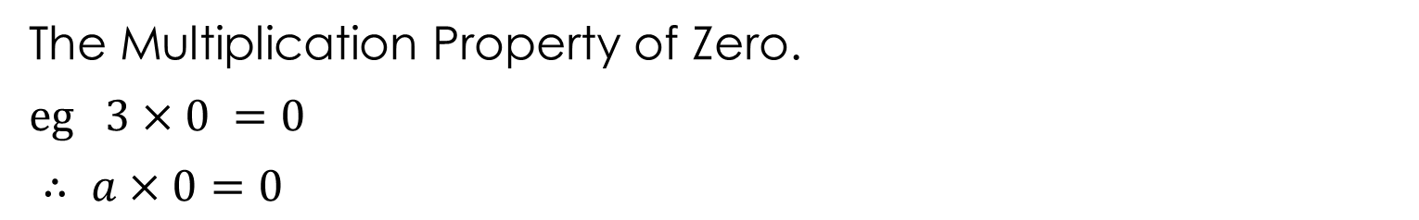
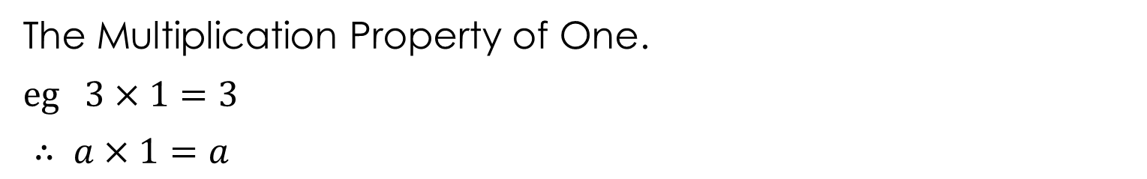
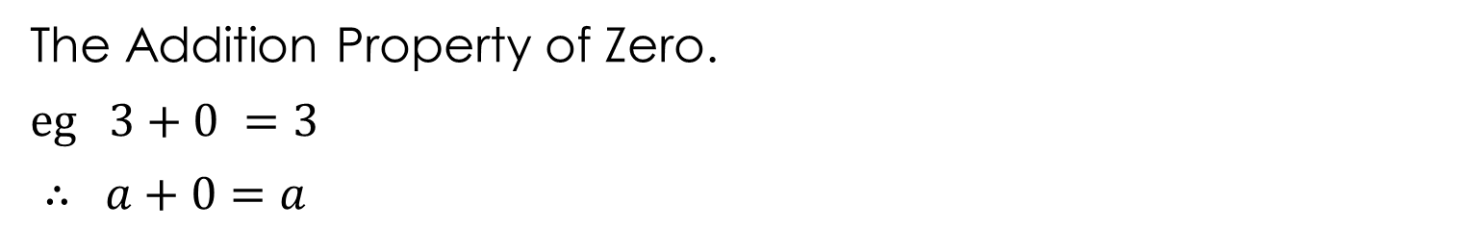
The Multiplication Property of One.
$eg 3×1=3$
$∴ a×1=a$
The Multiplication Property of Zero.
$eg 3×0 =0$
$∴ a×0=0$
The Addition Property of Zero.
$eg 3+0 =3$
$∴ a+0=a$

Slide 6
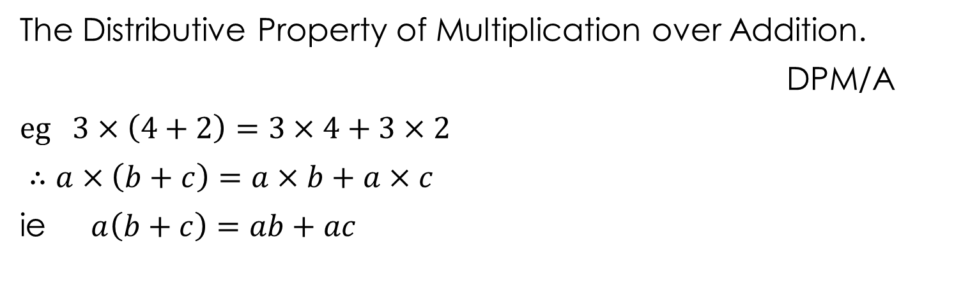
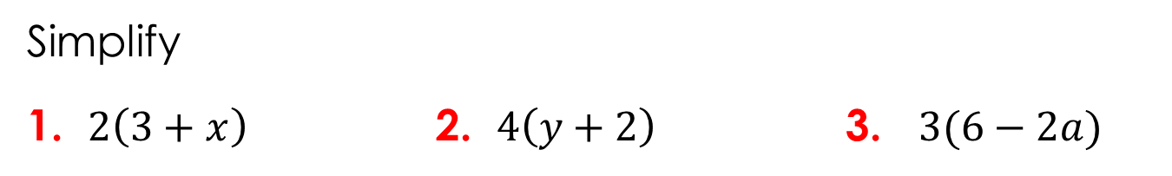
The Distributive Property of Multiplication over Addition.
DPM/A
$eg 3×\left(4+2\right)=3×4+3×2$
$∴a×\left(b+c\right)=a×b+a×c$
ie $a\left(b+c\right)=ab+ac$
Simplify
1. $2\left(3+x\right)$ 2. $4\left(y+2\right)$ 3. $3(6−2a)$
Notes:
Student worksheet

Slide 7
The Distributive Property of Multiplication over Addition.
DPM/A
$eg 3×\left(4+2\right)=3×4+3×2$
$∴a×\left(b+c\right)=a×b+a×c$
ie $a\left(b+c\right)=ab+ac$
Simplify
1. $2\left(3+x\right)$ 2. $4\left(y+2\right)$ 3. $3(6−2a)$

Slide 8
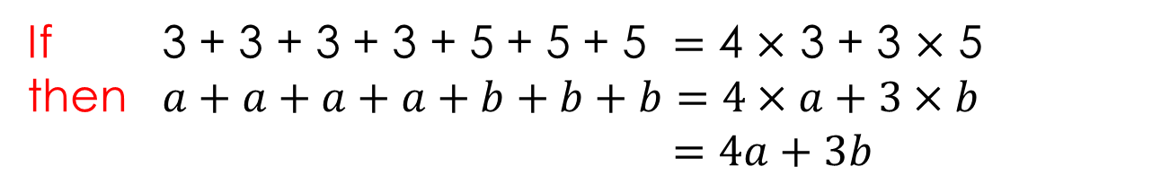
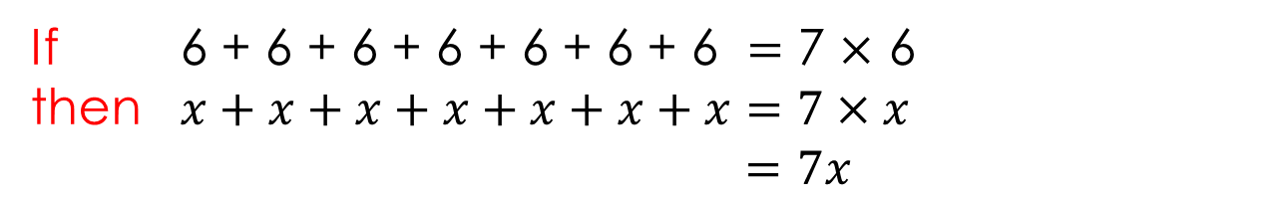
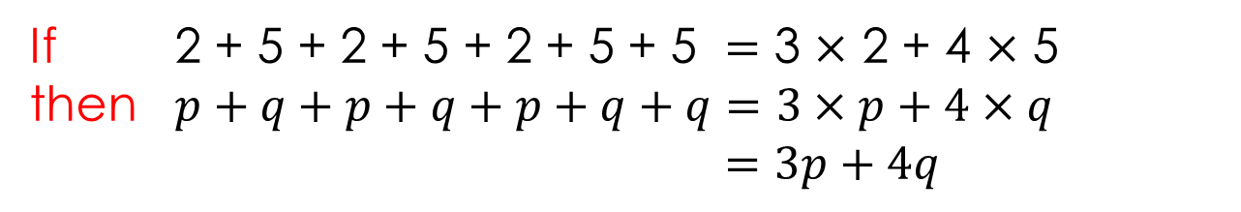
Number relationships.
If 6 + 6 + 6 + 6 + 6 + 6 + 6 $=$ 7 $×$ 6
then $x+x+x+x+x+x+x=7×x$
$=7x$
If 3 + 3 + 3 + 3 + 5 + 5 + 5 $=$ 4 $×$ 3 + 3 $×$ 5
then $a+a+a+a+b+b+b=4×a+3×b$ $=4a+3b$
If 2 + 5 + 2 + 5 + 2 + 5 + 5 $=$ 3 $×$ 2 + 4 $×$ 5
then $p+q+p+q+p+q+q=3×p+4×q$ $=3p+4q$

Slide 9
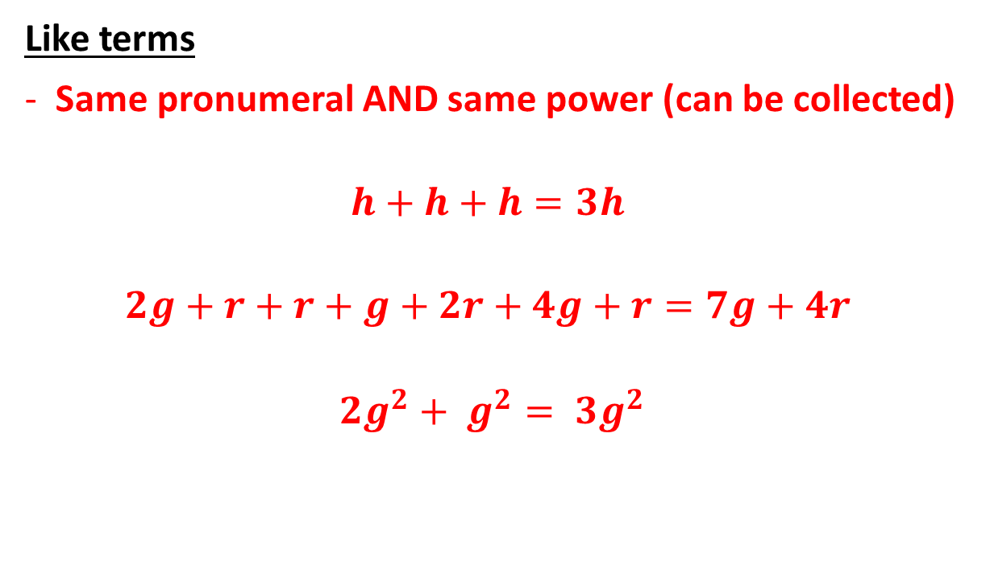
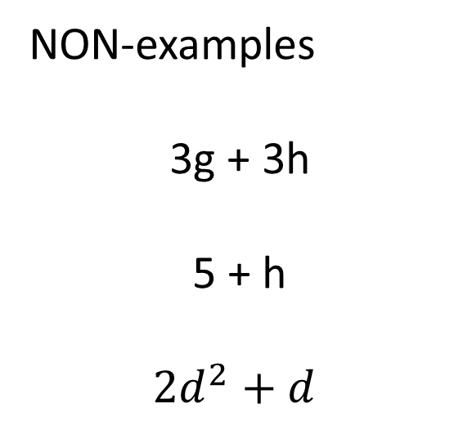
Terminology
Like terms
Same pronumeral AND same power (can be collected)
$$h+h+h=3h$$
$$2g+r+r+g+2r+4g+r=7g+4r$$
$${2g}^{2}+ g^{2}= {3g}^{2}$$
NON-examples
3g + 3h
5 + h
$${2d}^{2}+d$$
Notes:
Student worksheet

Slide 10
Terminology
Like terms
Same pronumeral AND same power (can be collected)
$$h+h+h=3h$$
$$2g+r+r+g+2r+4g+r=7g+4r$$
$${2g}^{2}+ g^{2}= {3g}^{2}$$
NON-examples
3g + 3h
5 + h
$${2d}^{2}+d$$

Slide 11


Slide 12
Exercise books.
Simplify each of the following
2w + 5w
4p + 3p
6y – 2y
5h + h
2k + 4r + 3k + 6r

Slide 13
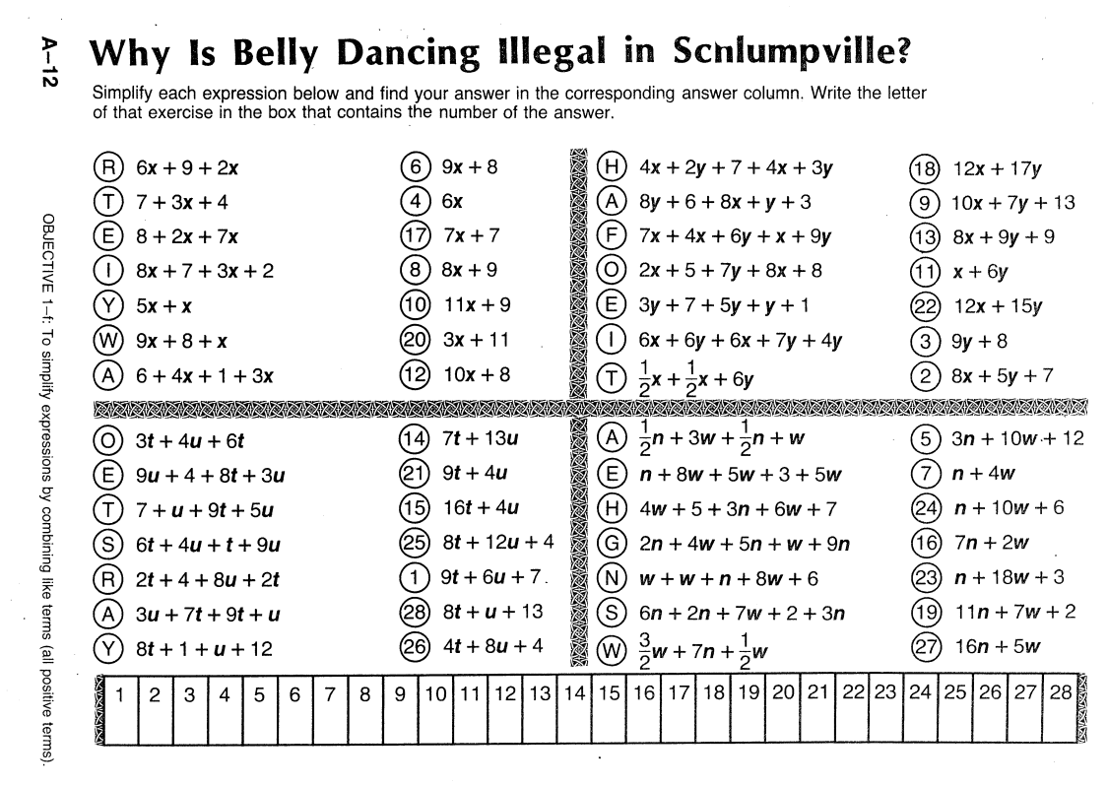

Slide 14
Reflection – Fist to five
Aims:
Understand that Number and Algebra use the same rules.
Describe like terms

